Slide 1
Secure Data Hiding in Image Using Steganography
CAPSTONE PROJECT
Presented By: Ganesh Suresh Beldar
Student Name : Ganesh Suresh Beldar
College Name & Department : Pravara Rural Engneering college,loni (IT)

Slide 2
OUTLINE
Problem Statement
Technology used
Wow factor
End users
Result
Conclusion
Git-hub Link
Future scope

Slide 3
Secure Data Hiding in Image Using Steganography
Secure data hiding in images using steganography involves embedding secret information within an image file in a way that is undetectable to the human eye. This process typically modifies the least significant bits (LSBs) of the image's pixels, ensuring minimal visual distortion while maintaining data integrity. The technique enhances privacy and security by concealing sensitive information in plain sight, making it difficult for unauthorized parties to detect or extract the hidden data.

Slide 4
Technology used
Python Libraries:
Pillow (PIL), Stegano, OpenCV, Cryptography.
Platforms/Tools:
MATLAB, Steghide, Zxing.
Technologies:
LSB Method, Cryptographic Algorithms, and occasionally Machine Learning.
Language:
html,css,javascript,python

Slide 5
Wow factors
Cryptographic Encryption: Combines encryption with steganography for double security.
Invisible Data Embedding: Uses the LSB method to hide data without affecting the image’s appearance.
Versatile Use Cases: Applicable for secure communications, digital watermarking, and covert data transmission.
Anti-Detection Mechanisms: Advanced techniques, like machine learning, help make hidden data harder to detect.
Enhanced Privacy and Security: Provides robust protection for sensitive information.

Slide 6
End users
Government Agencies: For secure communication and confidential data transmission.
Security Professionals: In cybersecurity to protect sensitive information and prevent data leaks.
Digital Forensics Experts: For detecting and analyzing hidden data in images.
Military Organizations: For covert communication and secure transfer of critical data.
Businesses and Corporations: To securely share proprietary information and trade secrets.

Slide 7
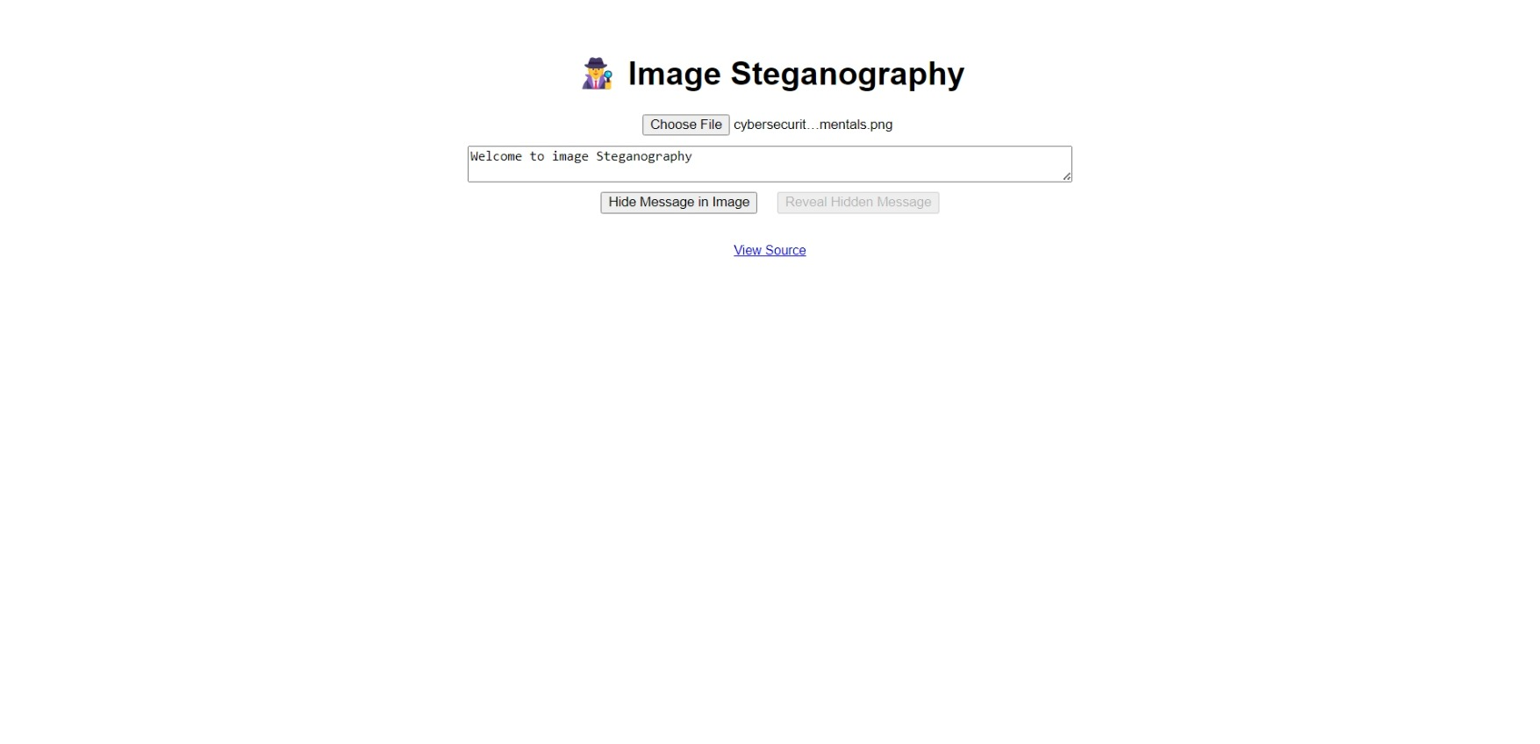
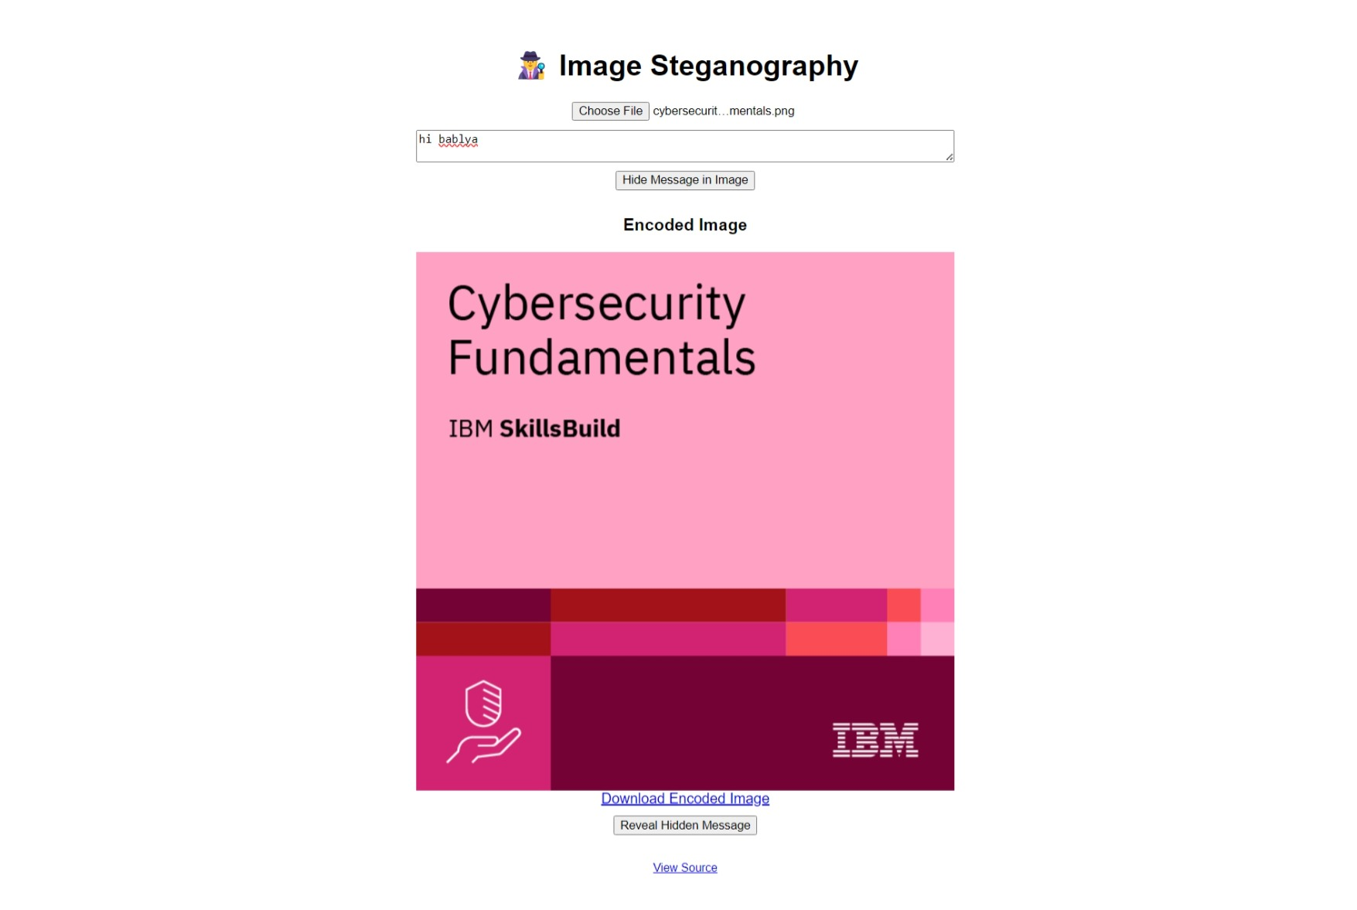
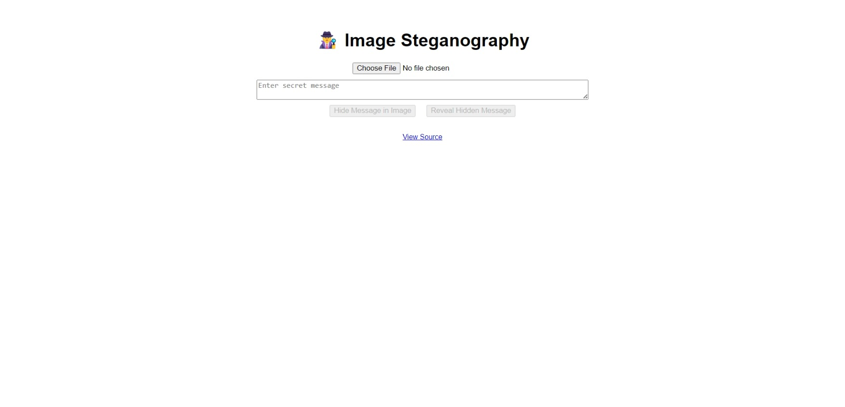
Results
Outputs:

Slide 8
Conclusion
In conclusion, the project "Secure Data Hiding in Image Using Steganography" successfully addresses the challenge of securely embedding and transmitting sensitive information. By integrating cryptographic encryption with the Least Significant Bit (LSB) method of steganography, this project ensures that hidden data remains undetectable to the human eye, thus providing a high level of security. The ability to hide information within digital images, coupled with its anti-detection mechanisms, makes it a powerful tool for secure communication across various domains such as government, military, and cybersecurity. The project not only protects data from unauthorized access but also ensures the integrity of the image, making it ideal for applications requiring both confidentiality and authenticity.

Slide 9
GitHub Link
https://github.com/Ganesh-Beldar/edunet_project.git

Slide 10
Future scope(optional)
Advanced Encryption: Integrating stronger encryption algorithms like AES or RSA for enhanced security.
Machine Learning: Using AI to make hidden data harder to detect.
Video Steganography: Extending the technique to video files for secure hiding of data.
Real-Time Hiding: Enabling real-time data hiding in live streaming or video calls.
Digital Watermarking: Using for intellectual property protection through embedded watermarks

Slide 11
THANK YOU

